Slide 1
Gas Station Traffic Profiles 7/2019 vs 7/2021
Presented by Ashley Rabanales, Brad Ashworth, Zack Lee

Slide 2
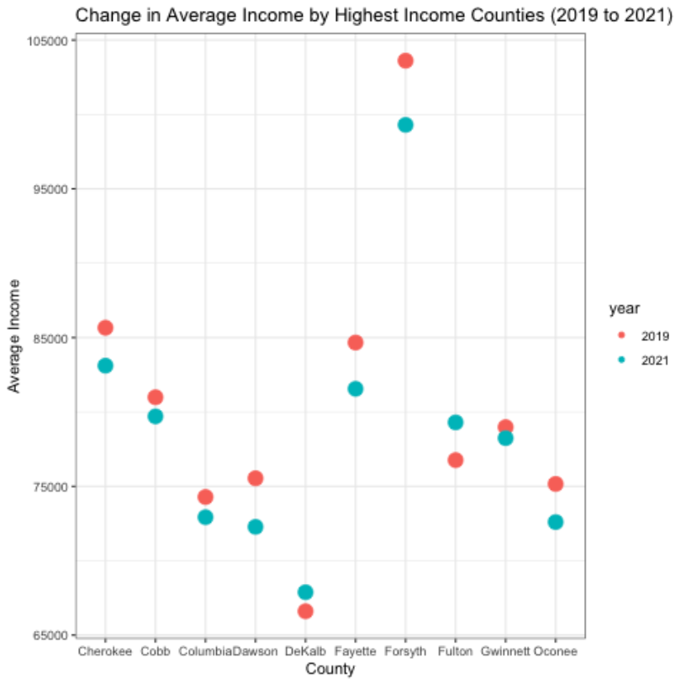
Change In Median Income By 10 Highest Median Income Counties
Median income for gas station customers had decreases in 8 of top 10 counties in GA between 7/19 and 7/21.

Slide 3
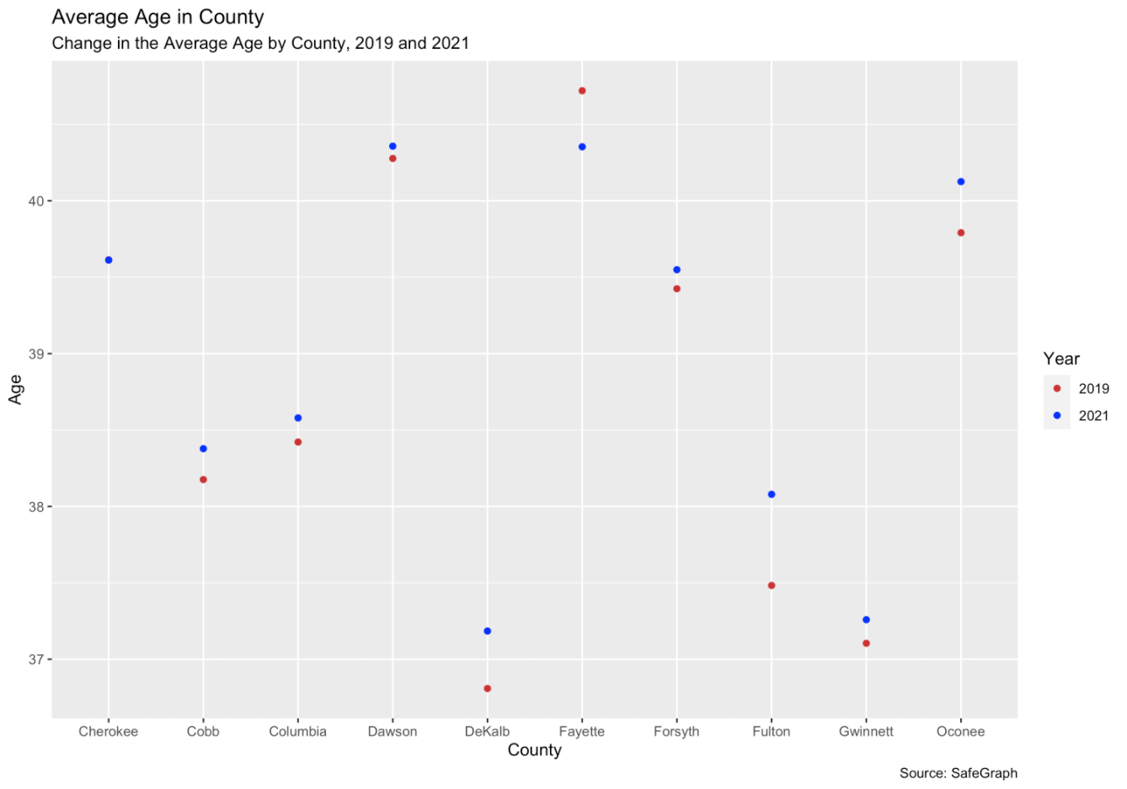
Change In Median Age By 10 Highest Median Income Counties
Median age had no abnormal shift between 7/19 and 7/21.

Slide 4
There are four counties with large shifts in the customer race mixes.

Slide 5
Follow Ups
Analysis By Brand
Analysis Per Capita
Additional research should be conducted by brands to determine if profile changes are across the industry, or specific to a brand.
Additional research should be conducted by per capita numbers to ensure no bias.
Analysis By Census Blocks
Analysis Additional Data
Additional research to be done on census block level areas to see if rural, suburban, and downtowns have the same impact.
Additional research to be done adding new data such as work from home statistics, jobs data, and electric car sales.
Analysis Of Other States
This analysis was started in GA but should be expanded to other states to determine if it is a localized phenomenon or throughout the USA.

